Slide 1
EVEL Library & Test Collector
December 9th, 2016
For Question Please Contact
Alok Gupta
+1 (732)-420-7007
ag1367@att.com

Slide 2
Agenda
Installation on Ubuntu
Build
    EVEL library
    Documentation
Unit Test
Demo

Slide 3
Ubuntu + Packages
Ubuntu Installation
    Started with a vagrant image ‘ubuntu/trusty64’, added xfce4
    Turned on file sharing to /vagrant, and loaded delivery files there.
Install required packages
    To browse documentation
      sudo apt-get install -y firefox
    To build EVEL library
      sudo apt-get install -y libcurl4-openssl-dev
      sudo apt-get install -y python-pip
    To run collector.py
      sudo pip install jsonschema
      sudo pip install functools32
    To run test_control.py
      sudo pip install requests

Slide 4
DOxygen
To enable building of documentation
    Manual installation of doxygen required:
      wget http://ftp.stack.nl/pub/users/dimitri/doxygen-1.8.12.linux.bin.tar.gz
      Unpack it
      Configure
      sudo make install

Slide 5
Unpack Delivery
Unpack EVEL
    mkdir ~/evel
    mkdir ~/evel/evel-library
    cd ~/evel/evel-library
    cp /vagrant/evel-library-package.tgz .
    tar xvf evel-library-package.tgz
    rm evel-library-package.tgz
Unpack COLLECTOR
    mkdir ~/evel
    mkdir ~/evel/evel-test-collector
    mkdir ~/evel/evel-test-collector/logs
    cd ~/evel/evel-test-collector
    cp /vagrant/evel-test-collector.tgz .
    tar xvf evel-test-collector.tgz
    rm evel-test-collector.tgz
    cd ~/evel/evel-test-collector/code/collector

Slide 6
Environment / Build
Configure environment:
    Add to ~/.bashrc:
      export LD_LIBRARY_PATH=/home/vagrant/evel/evel-library/libs/x86_64
      export PATH=$PATH:/home/vagrant/evel/evel-library/output/x86_64
You should now be able build and run
    cd ~/evel/evel-library/bldjobs
    make
    make docs
And browse the documentation:
    /home/vagrant/evel/evel-library/docs/source/evel/html/index.html

Slide 7
Demo
Username and Password
Mobile Flow
Service Events
Signaling
Syslog
State Change
Other
Event Throttling
Measurement Interval

Slide 8
Running The Collector
The configuration change in the collector:
    In the [windows] section, add the username and password:
      vel_username = will
      vel_password = pill
The command to run the collector:
    python collector.py -v --config ../../config/collector.conf --section windows

Slide 9
Running The DEMO
The command to run the demo application:
    evel_demo --fqdn localhost --port 30000 --verbose -c 20 -u will -w pill
    This runs 20 cycles, each cycle generating a set of events
The demo prints comments about changes in behaviour for a given cycle (i.e. 1 - 20), for example:
    1 - Resetting throttle specification for all domains
    5 - Switching measurement interval to 5s
    9 - Suppressing service event domain
    12 - Switching measurement interval to 10s
Increasing the number of cycles repeats the 20-cycle pattern.

Slide 10
Revised Demo 03/11/2016
Using ‘evel_training’ to demonstrate scenarios
    05 - Raise Fault – without username and password
    06 - Raise Fault – with username and password
    07 - Raise Measurement
    08 - Raise Mobile Flow
    09 - Raise State Change
    10 - Raise Syslog
    11 - Raise Other
    12 - Raise Fault – suppress fields
    13 - Raise Fault – suppress name-value pairs
    14 - Adapting to measurement interval
    15 – Raise Signaling
    16 – Raise Service Event

Slide 11
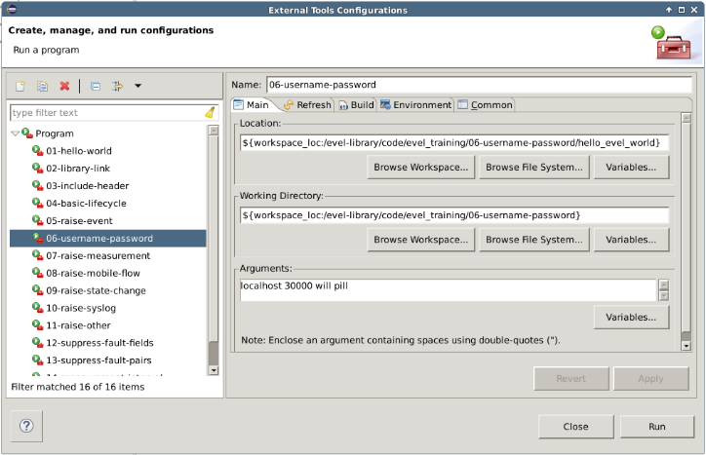
Eclipse Config

Slide 12
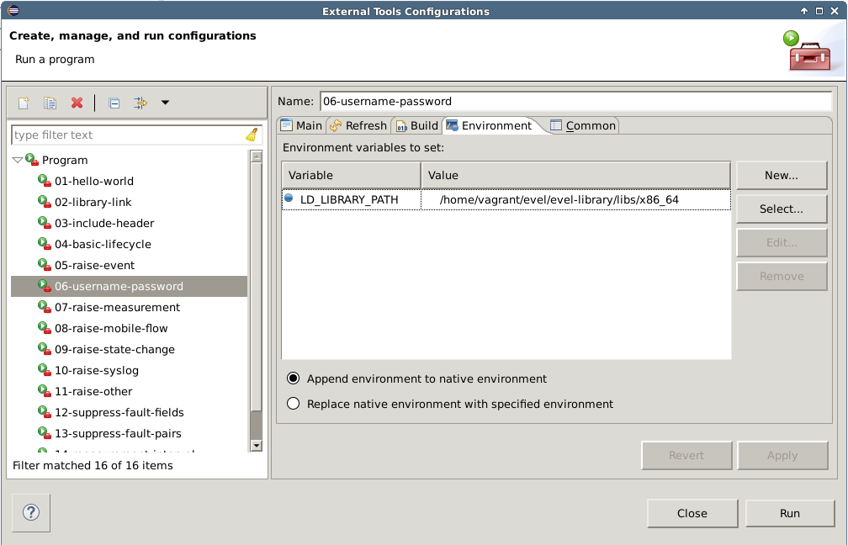
Eclipse Config

Slide 13
Test Control API
Test Collector has a new endpoint:
    http://<fqdn>:<port>/testControl/v1.1/commandList
Usage:
    Client POSTs a commandList to the test_collector.
    test_collector receives and stores the commandList.
    When test_collector receives the next event, it responds with the stored commandList and clears its local copy.
Manual usage:
    > python test_control.py –-fqdn=192.168.0.10 –-port=30000
    packaged with test_collector
Test usage:
    evel_demo uses functions in “evel_test_control.c” to drive API.
    evel_demo has a ‘-x’ option to stop it using the Test Control API.

Slide 14
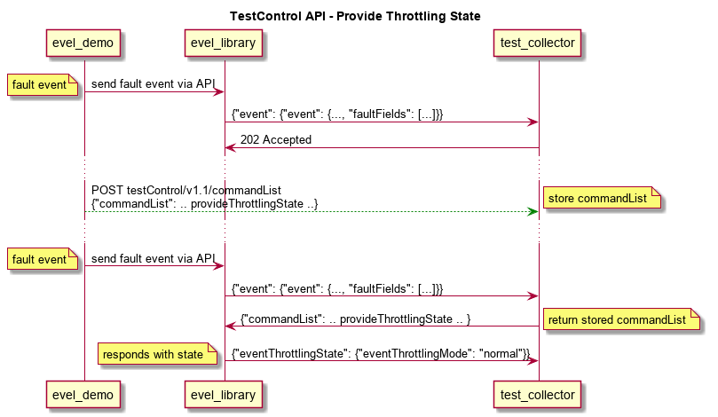
Test Control API
  Test Collector has a new “Test Control” API
  Test applications can post a commandList onto test_collector

Slide 15
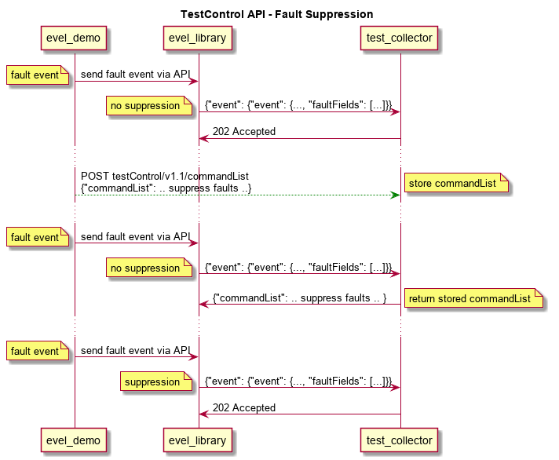
Test Control API – Fault Suppression

Slide 16
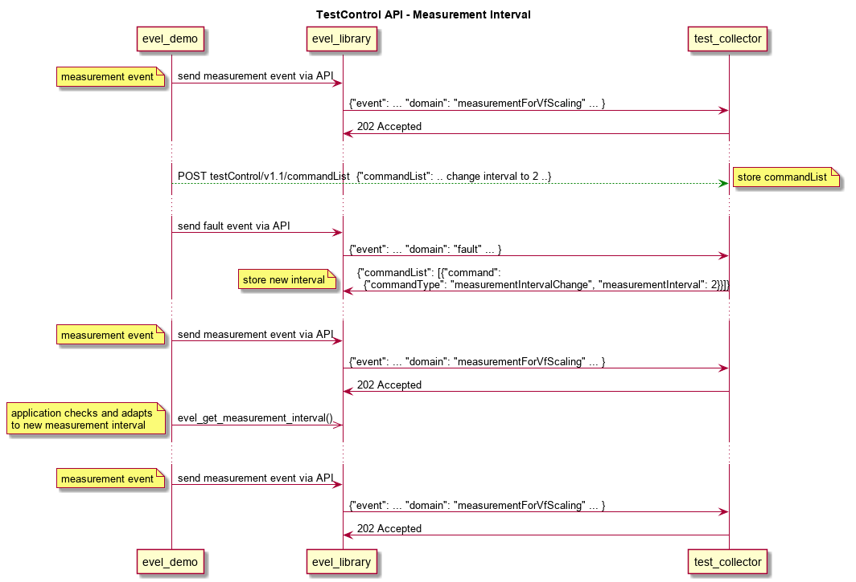
TEST CONTROL API – MEASUREMENT INTERVAL

